Slide 1
Drug Response prediction for cancer using phosphoproteomics data
Nasim Mohamed Ismail

Slide 2
Agenda
Introduction
Methods
Results
Discussion
What comes next?

Slide 3
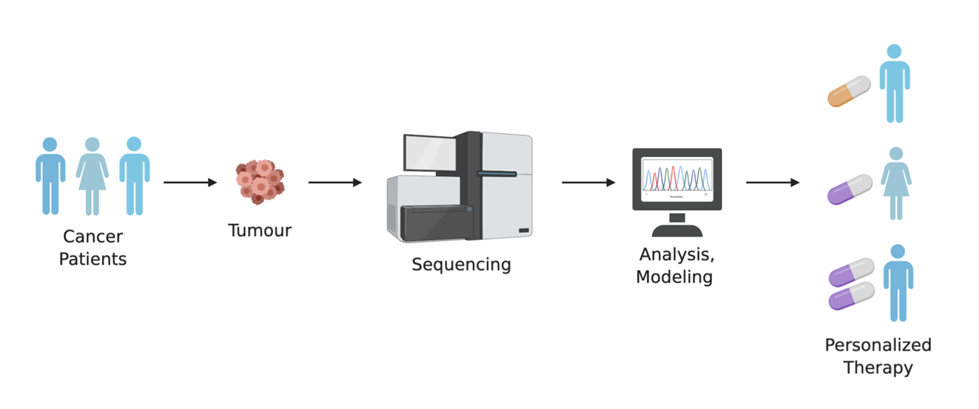
Drug response prediction and personalised medicine
Biomarker-based approach – biomarkers levels indicate drug responsiveness
Analytical models using deep learning could predict drug response without the need of specifying biomarkers
Notes:
Utilise high dimensionality data to build analytical models without requiring focus on specific biomarkers
Models can be used for deciding on best treatment, drug repurposing

Slide 4
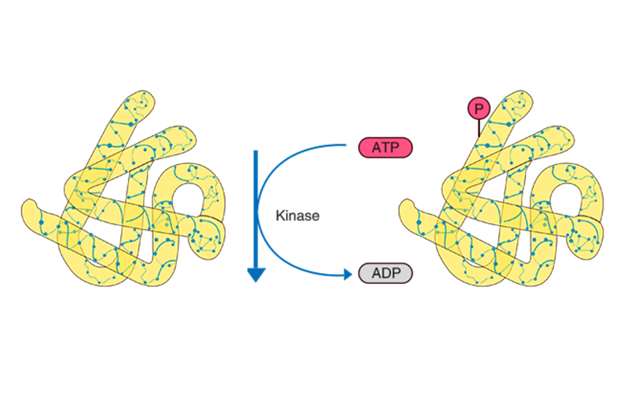
Phosphoproteomics
What is phosphorylation?
Post-translational modification
Phosphate group is transferred to amino acid residue
Why use phosphoproteomics?
Kinase signalling pathways are dysregulated in cancer pathologies
Notes:
PTM involved in regulation of almost all cellular processes
Kinase signalling pathways are implicated in cancer pathology
Many drugs directly interact with proteins
Yet use of phosphoproteomics data in drug response prediction has not been fully explored

Slide 5
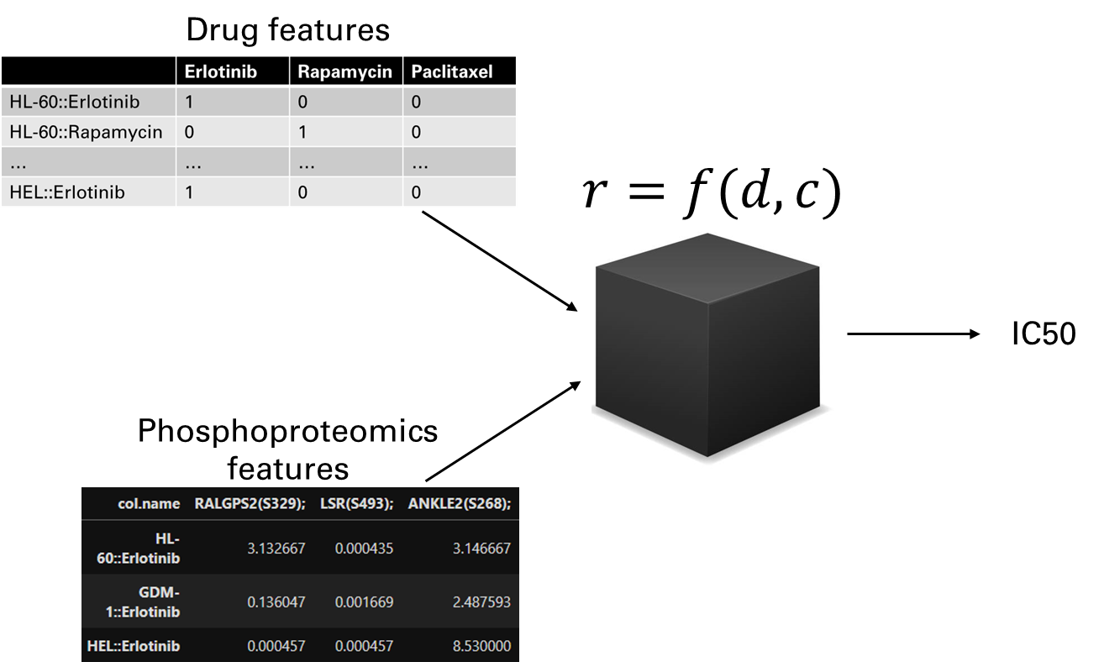
Drug response prediction
Model learns relationship of cancer data features with drug response outcomes
Trained model predicts drug response from unseen data
Notes:
Drug response outcomes in IC50 data for each drug-cell line pair
IC50 – concentration required to reach 50% of drug’s maximal inhibitory effect

Slide 6
methods

Slide 7
Methods
Phosphoproteomics LCMS/MS data
IC50 drug response data
Reduce omics data to most useful features
Normalisation of target values
Random Forest
XGBoost
Neural networks
Model performance evaluation
• R2
• MSE
Phosphoproteomics & IC50 target value data
Feature Selection
Pre-processing
Supervised learning algorithms
IC50 predictions
Notes:
Outline of the project’s methods

Slide 8
Methods
Feature Selection
Landmark kinase targets
Substrate specificity
Functional scoring
Supervised learning algorithms
Random Forest
XGBoost
Neural networks
Notes:
Models were training with a 75/25 train-test split
Model optimisation was done using k-fold cross-validation on the training data
Splitting was cancer-blind where no samples across each split have overlapping cell lines

Slide 9
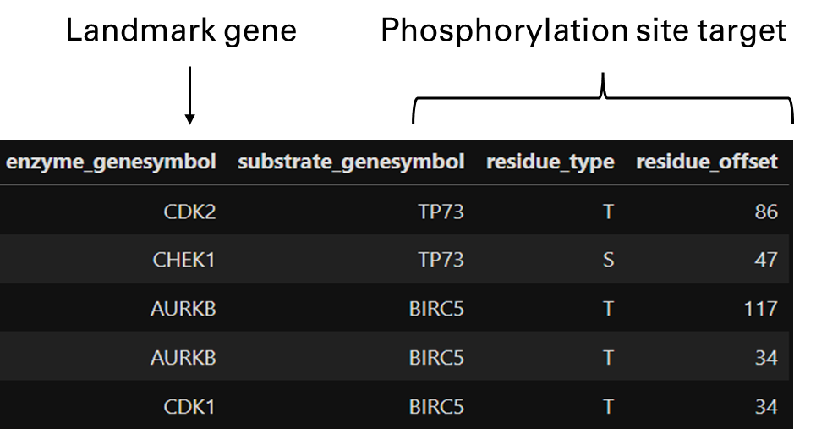
Landmark genes
1000 genes representative of 82% of the human transcriptome
Notes:
Study determined top 1000 gene transcripts
Figure of phosphorylation database dataframe
Filter landmark genes for kinases
Find phosphosite targets of landmark kinases

Slide 10
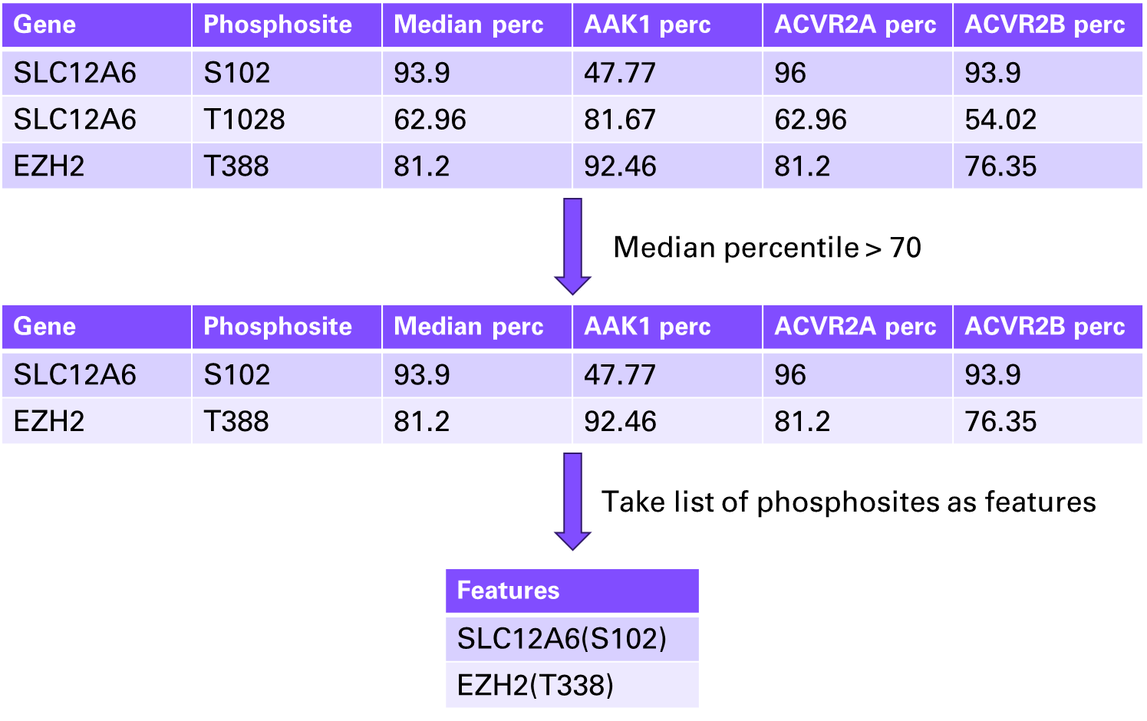
Substrate specificity feature selection
Notes:
Using dataset with phosphosite specificity for 303 Ser/Thr kinases
Substrate specificity shown as a percentile of specificity across all phosphosites in datasets

Slide 11
Substrate specificity feature selection

Slide 12
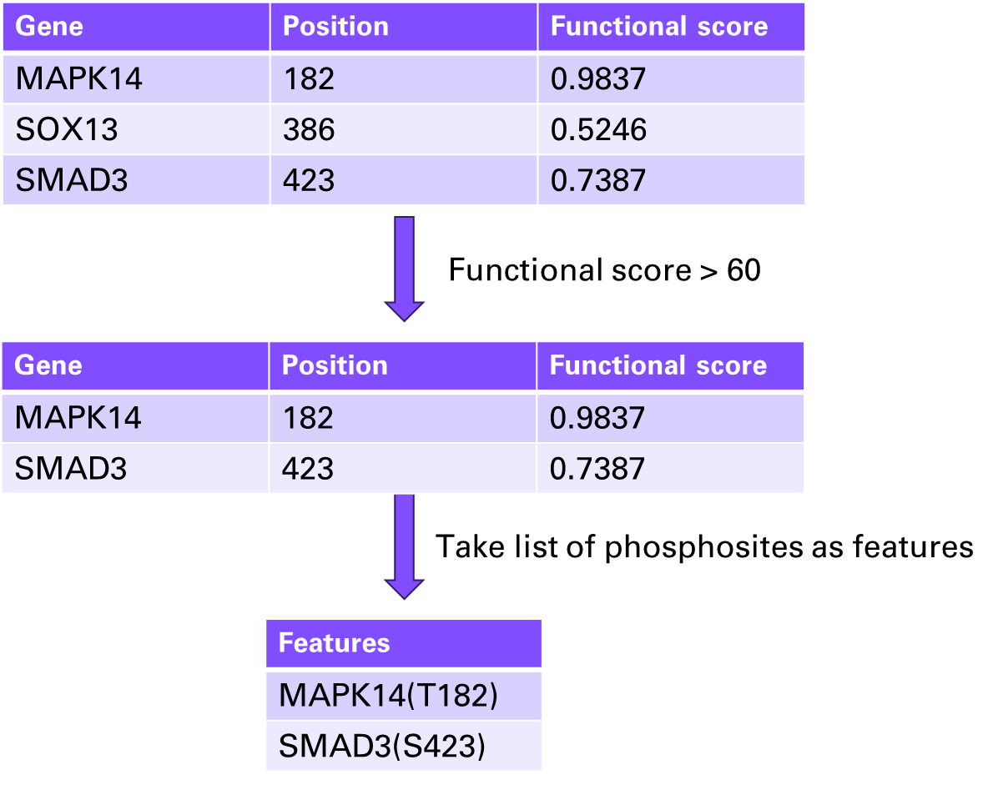
Functional score feature selection
Notes:
Functional landscape of human phosphoproteome
Functional scores derived from 59 features indicative of proteomic, structural, regulatory or evolutionary relevance

Slide 13
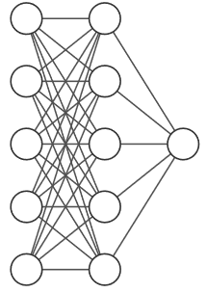
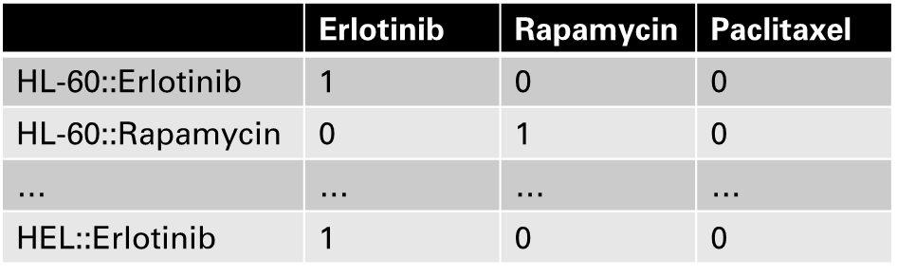
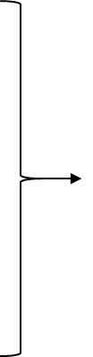
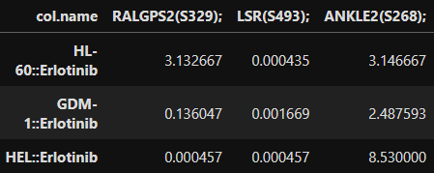
Neural network architecture
Drug features
IC50
Phosphoproteomics features
Notes:
Phosphoproteomics data and drug features were fed through separate dense layers before being concatenated and processed through a final set of dense layers to get the prediction
Briefly mention that convolution was used for phospho data
Also briefly mention that hyperparameters were optimised

Slide 14
Results

Slide 15
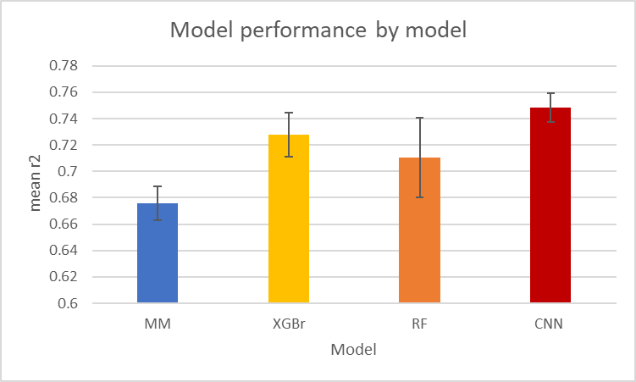
Results
Benchmark (MM) -> mean DRP for drug across all cell lines
All ML models using landmark gene target feature selection
Average ranking:
CNN - 1.067
XGBr – 2.133
RF – 2.867
MM – 3.933
Notes:
Exploration of how different models perform with phosphoproteomics data
Explain mean model
All machine learning models outperformed mean model
CNN outperformed all models overall with more stable performance shown by narrower standard deviation error bars
Which demonstrates the predictive power of deep learning models for drug response prediction
NN better able to model the relationship between phosphoproteomics features with drug response in cancer cell lines

Slide 16
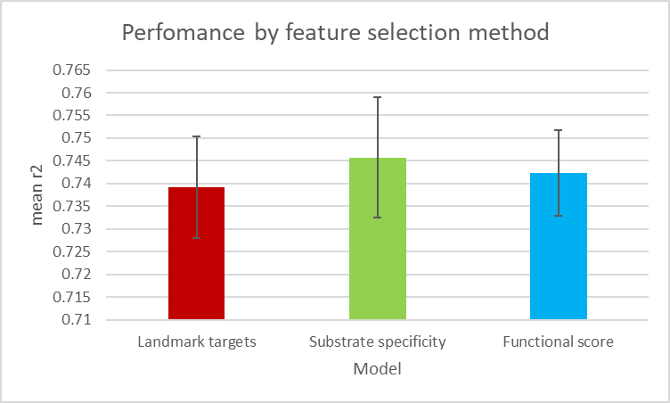
Results
Three feature selection methods
Average ranking:
LM targets – 2.467
Substrate specificity – 1.600
Functional score – 1.933
Notes:
Change narrative so that landmark targets is baseline used in previous

Slide 17
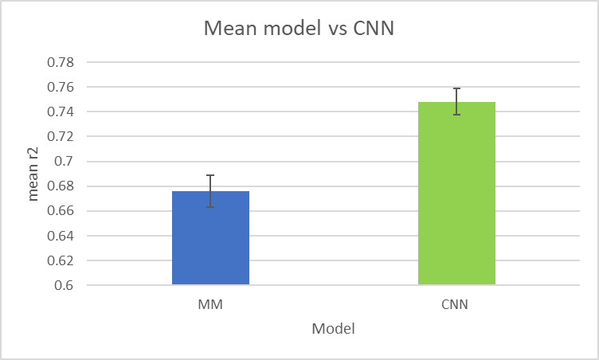
Results
Notes:
Best performing feature selection method against mean model

Slide 18
Conclusions
Neural networks achieve increased DRP performance over traditional ML algorithms
Feature selection integrating additional phosphorylation data enhances model performance
Notes:
Point 1
- increased overall prediction performance
- in addition, neural networks shown to improve the actual stability of predictions
Point 2
demonstrates the importance of feature selection in preparing input to improving drug response prediction models
Importance for DRP beyond model architecture and hyperparameter tuning

Slide 19
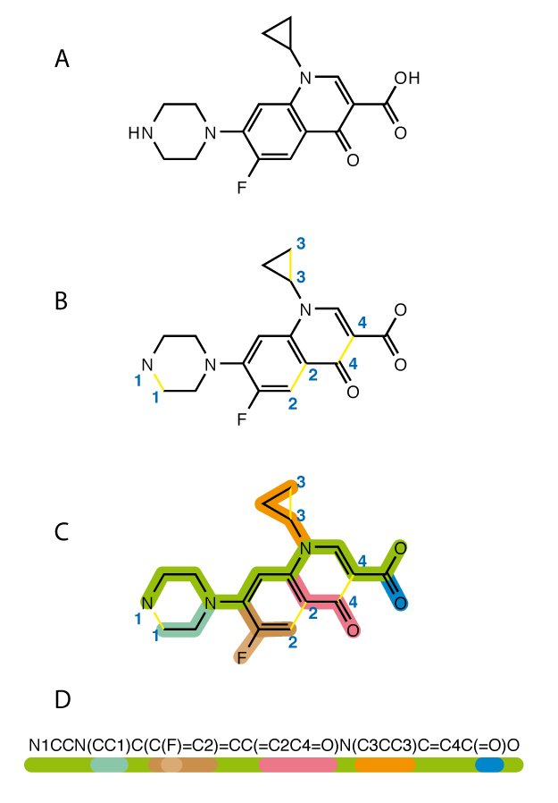
What comes next
Using more complex drug features - SMILES
Phosphoproteomics vs proteomics & genomics
Multi-omics models (Phospho+Proteomics)
Notes:
SMILES (Simplified molecular-input line-entry system) - More complex drug representation allows model to learn to associated molecular features of drug with DRP outcome

Slide 20
Thank you for listening

